Slide 1

Indoor Plant Monitoring System Using IoT
by
A. Likhitha
Roll No. 204G1A0548
R. Lalitha
Roll No. 204G1A0547
K. Asha Nidhi
Roll No. 204G1A0516
K. Hema Latha
Roll No. 204G1A0539
Under the guidance of
Dr. B. HariChandana M.Tech.Ph.D
Associate Professor
Department of Computer Science and Engineering
Srinivasa Ramanujan Institute of Technology
(Autonomous)
2023 - 2024

Slide 2

Contents
Review-0 comments
Review-1 comments
Abstract
Problem statement
Objectives of Project
Literature survey for first objective
Objective-1 (Design & Implementation)
Literature survey for second objective
Objective-2 (Design & Implementation)
Proposed Work -(Methods to be followed for proposed system)
References
GitHub Link
Queries

Slide 3
Review-0 Comments
Add more links for the literature review, you have done.
What are the ideal temperature ranges for plants to survive?
More details on object detection.
In what way does this project deal with motion detection?

Slide 4
Plant Sustainability
Temperature, Humidity and Moisture Factors For Plant Sustainability
Temperature and Humidity reference
There are typically three main temperature points of plant growth. These refer to the minimal, optimal, and maximum temperature.
Vegetative phase – 25 degrees Celsius and 60-70% humidity.
Flowering phase – 28 degrees Celsius and 40-50% humidity.
Soil Moisture reference
It is important to note that the majority of flowers, trees, and shrubs require moisture levels between 21% - 40%, while all vegetables require soil moisture between 41% and 80%.

Slide 5
Review-1 Comments
How to adjust the temperature?
How to consolidate humidity of different various plants?

Slide 6
Review-1 Comments
To control temperature:
Monitor temperature regularly.
Provide shade in warmer climates.
Optimize room layout by arranging furniture to promote improved airflow.
To consolidate humidity:
use pebble trays.
Regularly mist plants, but avoid over-misting.
Modify watering based on humidity requirements.

Slide 7
Abstract
Nowadays, a lot of individuals are quite interested in doing their own gardening. Indoor gardening has a variety of advantages, including the ability to produce organic vegetables, use of the plants in home design, and air purification. People's busy schedules are the major obstacle to indoor gardening because plants require more attention for their growth and health, necessitating the hiring of a "plant sitter" if they leave on vacation. This problem can be solved by automating the plant monitoring using the "Internet of Things". Utilizing Raspberry pi and variety of environmental sensors, and camera module, to track the temperature, moisture and many other aspects and providing data on each of these elements via PushBullet.
Keywords: Indoor planting, Plant sitter, Raspberry pi, Camera

Slide 8
Problem Statement
Due to people's hurried lifestyles, indoor plants don't receive the attention they need, which has an effect on their growth and robustness.
To maintain the plant’s growth, a predetermined temperature, moisture, light and humidity levels as well as to spot bird activity, environmental factors must be continuously monitored and managed.

Slide 9
Objectives of Project
Research Objective-1: To prevent overheating through tracking the temperature using DHT 11 and monitoring the moisture level of the soil using moisture sensor and notifying the user via in-app notification the PushBullet.
Research Objective-2: To provide shade to the plants when temperature is high. To water the plants using water pump automatically through assessing the soil's moisture content.To secure the existence of plant through the utilization of a network of various sensors that safe guard against the consequences of bird activity.

Slide 10
Proposed System
To address the limitations of the existing system, we propose implementing a comprehensive solution, that employs a combination of various environmental sensors, which will constantly monitor variables such as humidity, moisture and temperature fluctuations to provide shade to the plant, and smart gadgets like camera module to track the presence of birds and make a buzzer sound.

Slide 11
Literature survey for first objective
This paper includes integrating the Raspberry Pi as the core component, serving as a unifying element for the entire module. This consolidation incorporates an array of sensors that are linked to the Raspberry Pi. Also discusses, soil moisture sensor's purpose, which is primarily centred on identifying moisture present within the soil. Maintaining the right balance of moisture is essential to ensure proper nutrient absorption and prevent water stress. Soil moisture sensors are devices designed to measure the amount of water present in the soil. [1]

Slide 12
Continued…
This study elaborates a system with various sensors that detect humidity, temperature, and soil moisture. This technology uses IoT (Internet of Things) to irrigate and monitor the plant. Also offers information on the most suitable ranges of the plant's key sustainability parameters. Plant watering and monitoring system technologies will deliver input to the user via smart phones or laptops in this paper. The automated system will eliminate the requirement for man power, lowering the possibility of error. [2]

Slide 13
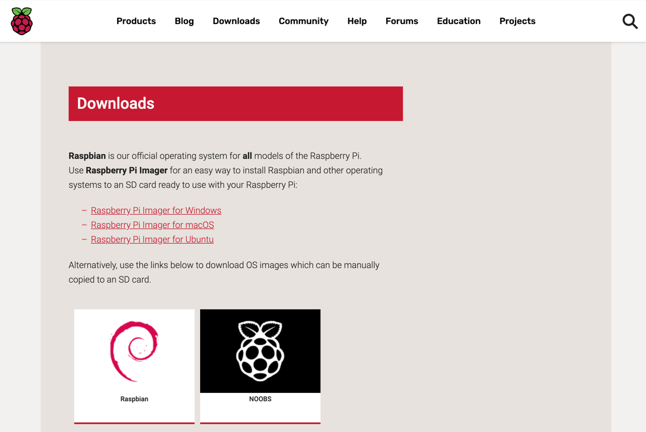
Design and implementation of first objective
The first step of the project is to download the Raspbian OS into the Raspberry Pi using the SD card.
Steps to download the OS:
Step 1: Download the Required Software and Files
Step 2: Get the SD Card and the Card Reader
Step 3: Check the Drive in Which the SD Card is Mounted
Step 4: Formatting the SD Card
Step 5: Write the OS on the SD Card
Step 6: Eject the SD Card
Link to download and installation of Raspbian OS

Slide 14
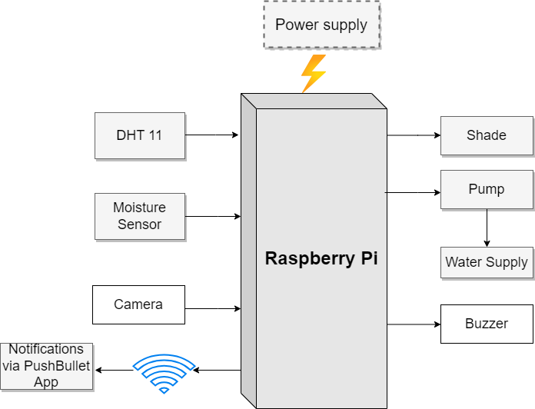
Design and implementation of proposed system
Fig-1: Block Diagram of proposed system

Slide 15
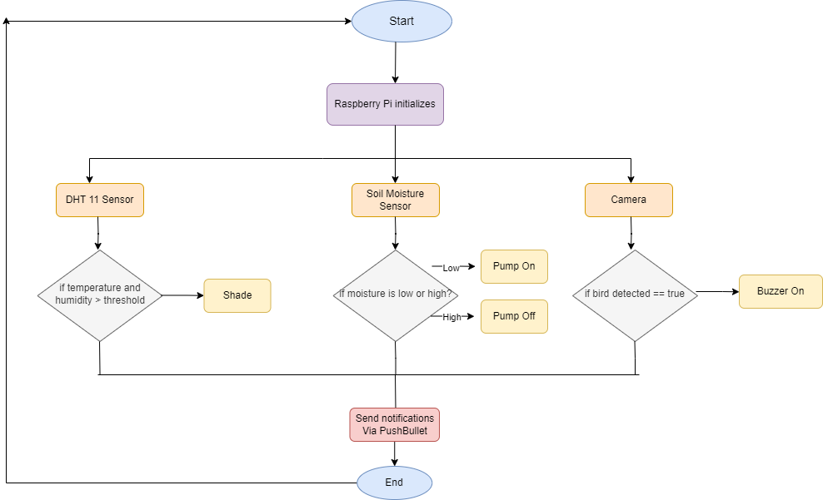
Design and implementation of proposed system
Fig-2: Flow Diagram of Plant Monitoring System

Slide 16
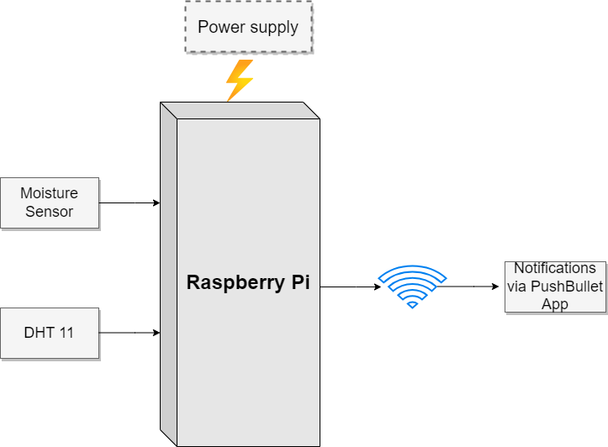
Design and implementation of first objective
Fig-3: Block Diagram for monitoring moisture and temperature

Slide 17
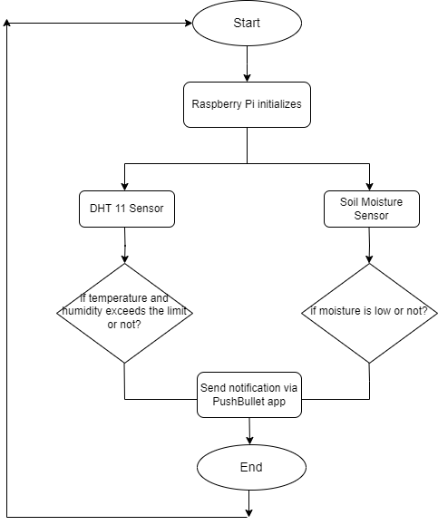
Design and implementation of first objective
Fig-4: Flow Diagram to keep track of temperature and moisture

Slide 18

Design and implementation of first objective
Raspberry Pi and Pins

Slide 19
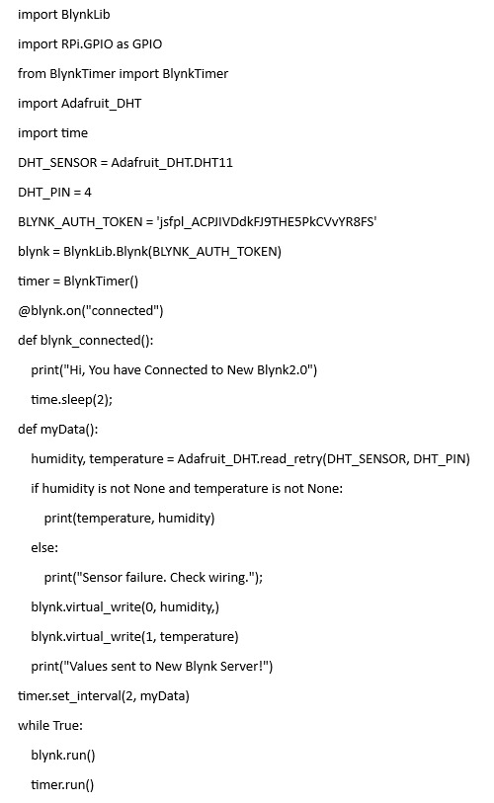
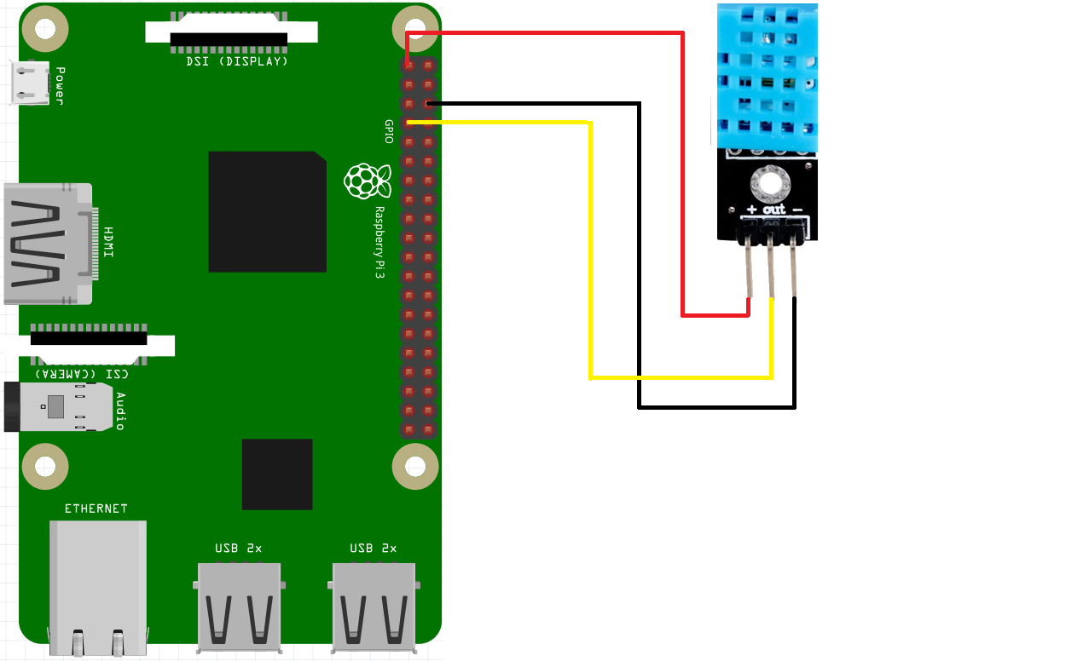
Design and implementation of first objective
Implementation of DHT 11 Sensor

Slide 20
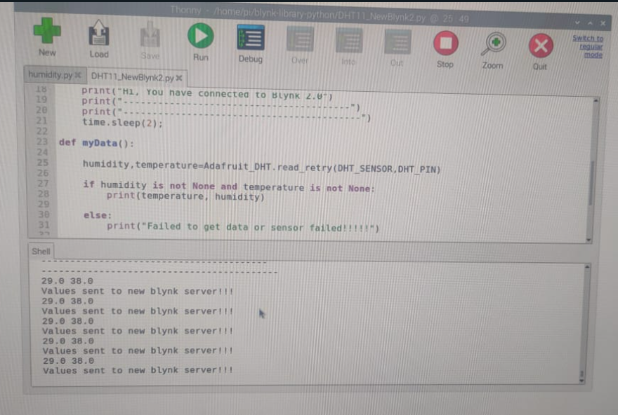
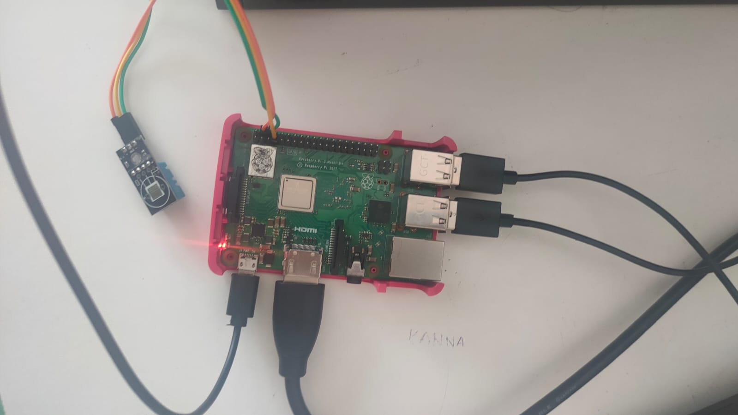
Design and implementation of first objective
Monitoring temperature and humidity through DHT 11 Sensor

Slide 21
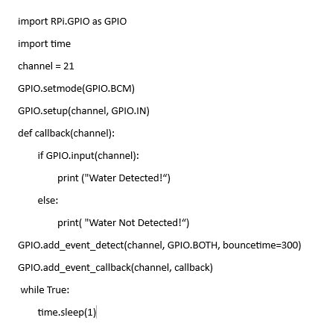
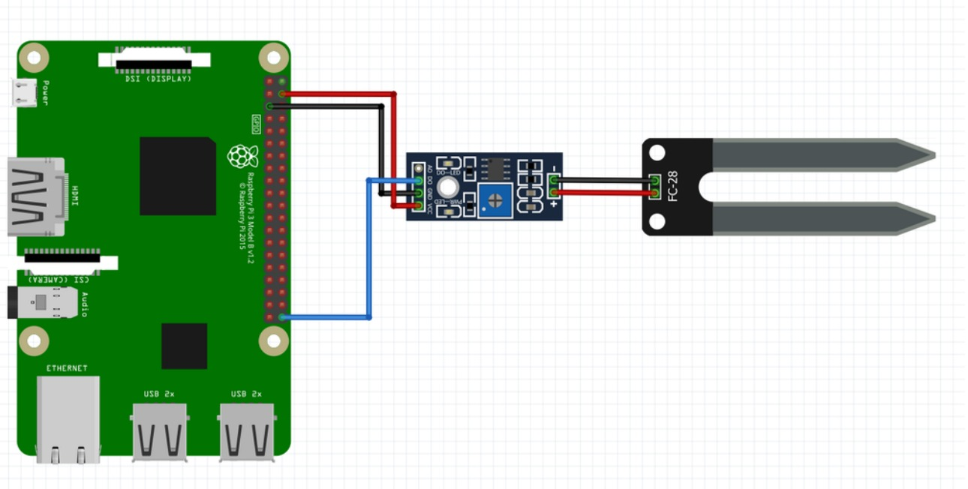
Design and implementation of first objective
Implementation of Soil Moisture Sensor

Slide 22
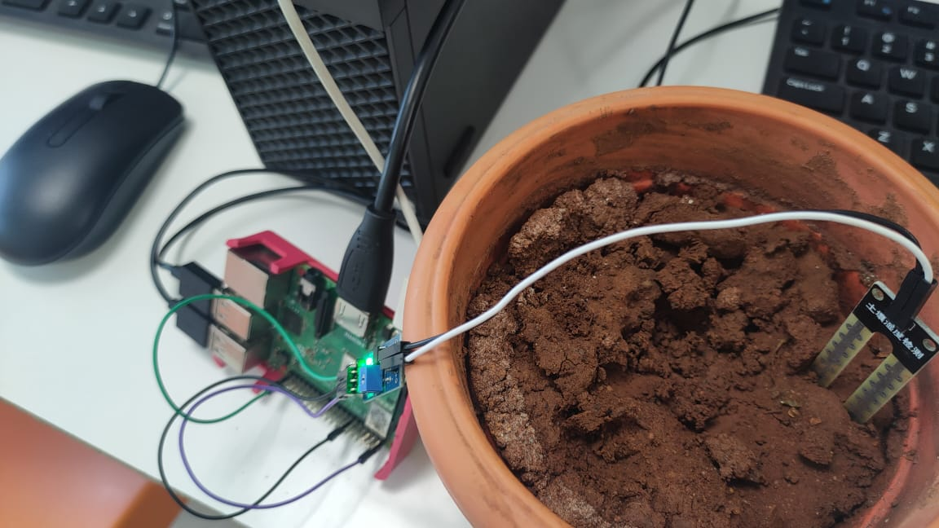
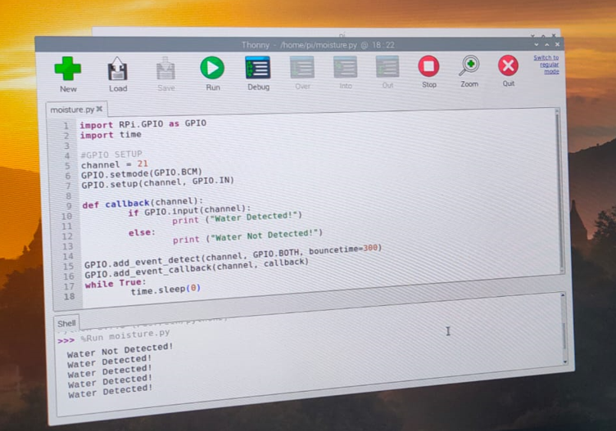
Design and implementation of first objective
Detecting water using Soil Moisture Sensor

Slide 23
Literature survey for second objective
This paper is divided into three divisions: animal detection and identification (to detect and identify the presence of animals), alarm (to activate the buzzer to keep the animal away from the field), and GSM module (to send alert messages to the authorized person). When an animal enters the field, the sensor detects its presence. It begins calculating the distance and sends the signal to the camera to begin photographing. This image is then compared to the previously saved dataset, and the animal is identified. When the distance exceeds the threshold value, the buzzer sounds and an alarm message is sent to the appropriate people. [3]

Slide 24
Continued…
This research paper illuminates the utilization of the PushBullet within a plant monitoring system, showcasing its widespread adoption as a convenient approach for remotely overseeing and managing plant conditions. The discussion underscores the prevalent adoption of PushBullet as a user-friendly and effective avenue for remotely managing and monitoring plant conditions. PushBullet emerges as a prominent IoT platform, empowering users to craft personalized mobile applications tailored to their IoT ventures.[4]

Slide 25
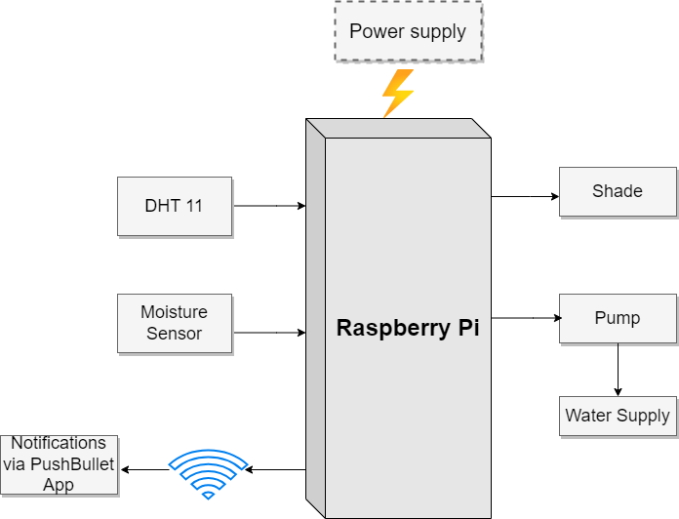
Design and implementation of second objective
Fig-5: Block Diagram for providing shade and water

Slide 26
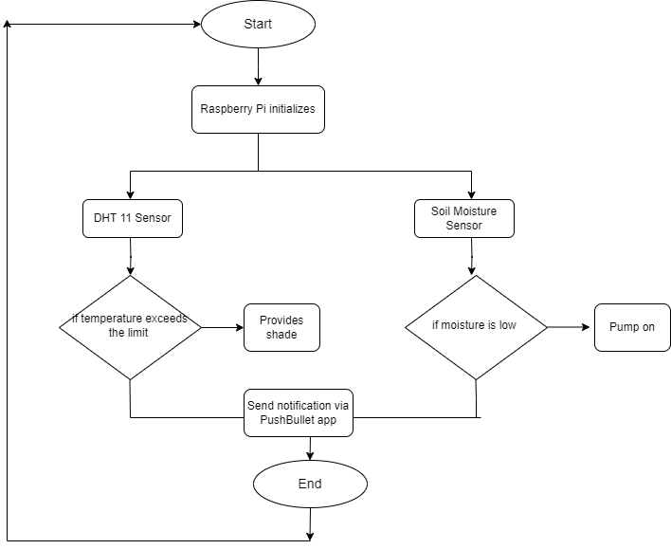
Design and implementation of second objective
Fig-6: Flow Diagram to keep track of temperature to provide shade and moisture to water plant

Slide 27
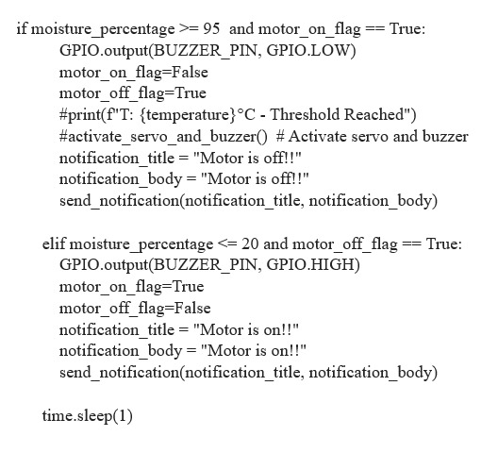
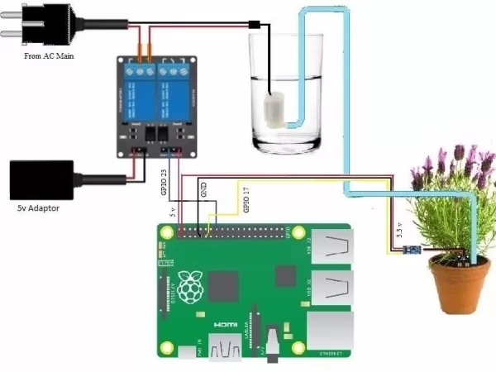
Design and implementation of second objective
Implementation of relay module to pump the water

Slide 28
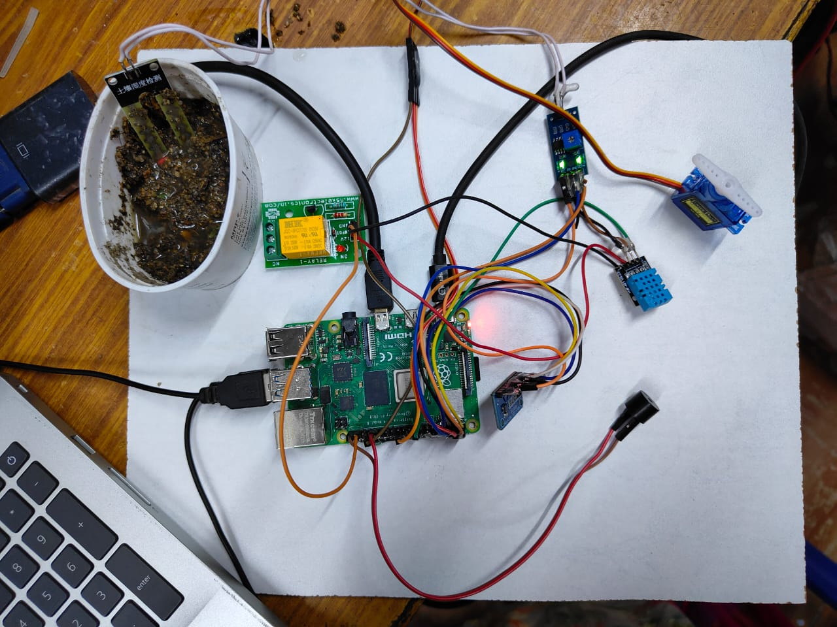
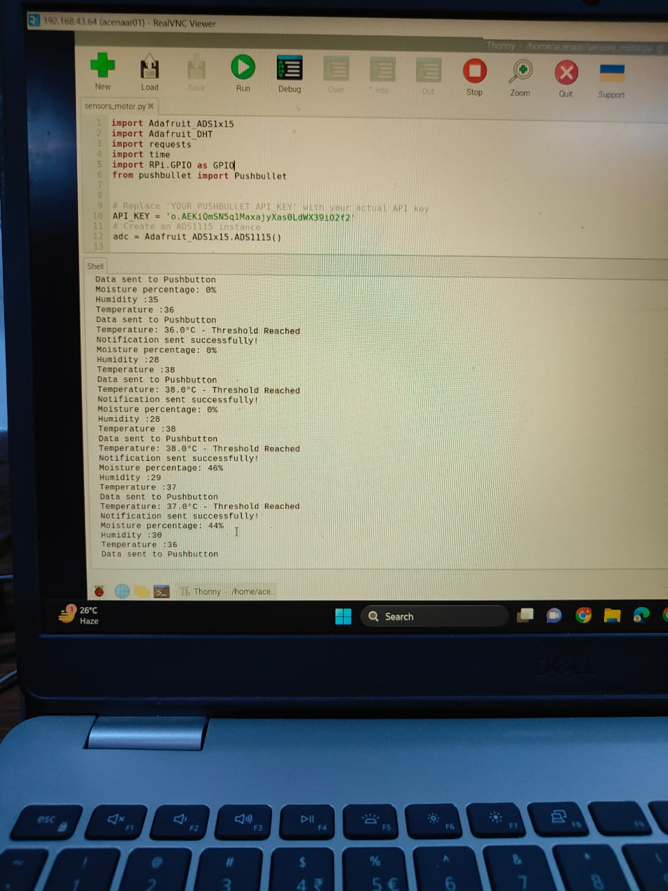
Design and implementation of second objective
Pumping the water using relay

Slide 29
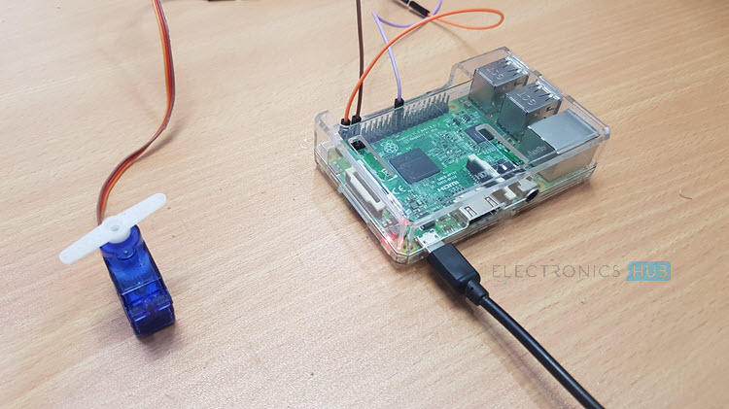
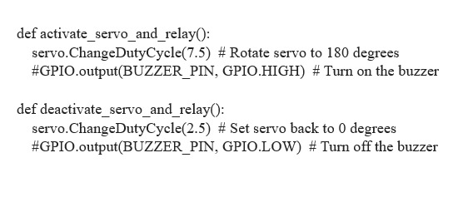
Design and implementation of second objective
Implementation of servo motor to provide shade

Slide 30
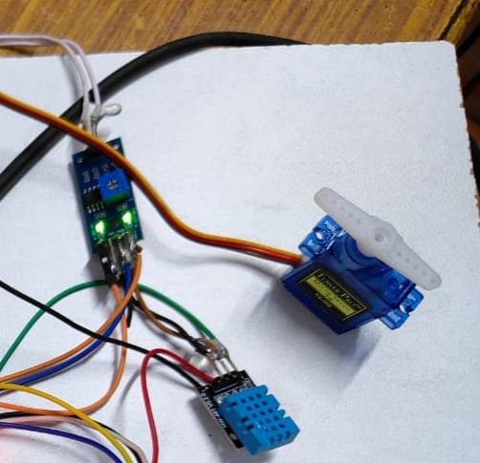
Design and implementation of second objective
Providing shade to the plant using servo motor

Slide 31
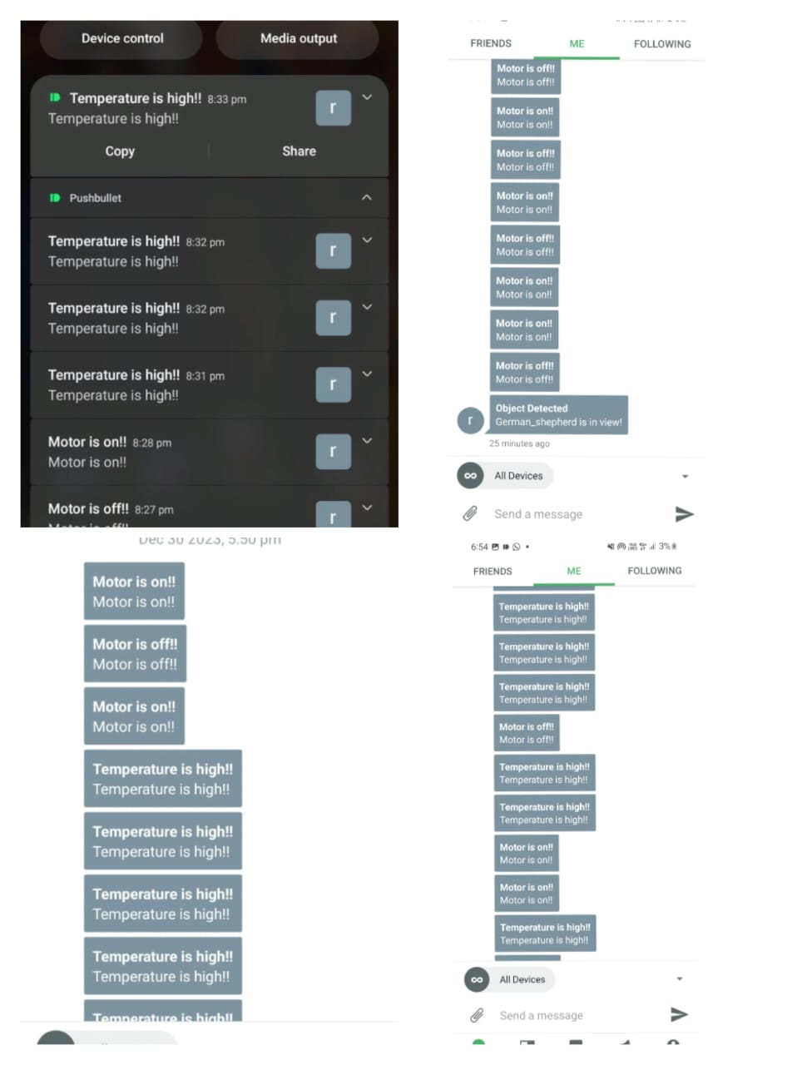
Design and implementation of Second objective
PushBullet in-app notifications

Slide 32
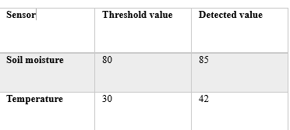
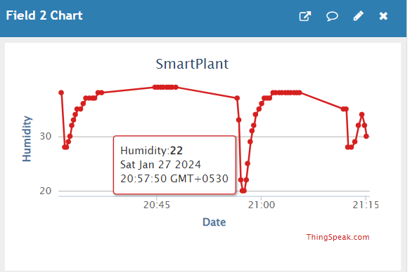
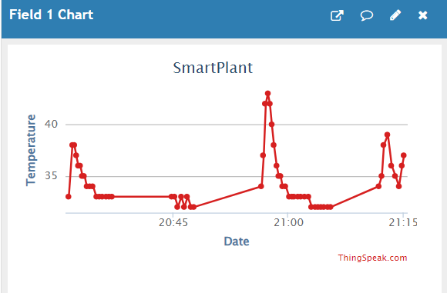
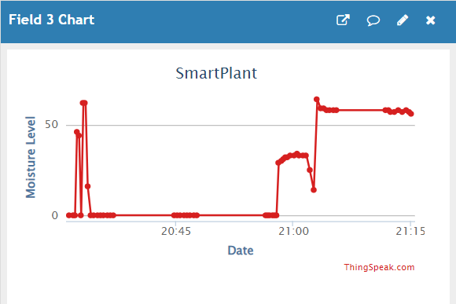
Design and implementation of Second objective
Temperature, humidity and moisture metrics

Slide 33
References
[1]. Zuraida Muhammad, Muhammad Azri Asyraf Mohd Hafez, Nor Adni Mat Leh, Zakiah Mohd Yusoff and Shabinar Abd Hamid, “Smart Agriculture Using Internet Of Things with Raspberry Pi”, 10th IEEE International Conference on Control System, Computing and Engineering (ICCSCE2020) pp. 85-90, August. 2020.
[2]. Ms. Yogeshwari Barhate, Mr. Rupesh Borse, Ms. Neha Adkar and
Mr. Gaurav Bagul, “Plant Watering and Monitoring System Using IOT and Cloud Computing” International Journal of Scientific Development and Research vol. 5, pp. 157-162, April. 2020.

Slide 34
Continued…
[3]. Selvamuthukumaran N, Evangeline Sneha J, Thriambika K B and Vishali Babu B, “Intelligent Animal Detection System Using IOT and Deep Learning” International Research Journal of Modernization in Engineering Technology and Science, vol. 3, pp. 2433-2438, April. 2021.
[4]. Yogesh kumar Jayam, Venkatesh Tunuguntla, Sreehari J B, S Harinarayanan , “Smart Plant Monitoring System Using IOT” Fourth International Conference on Trends in Electronics and Informatics (ICOEI 2020),pp. 271-277, July. 2020.

Slide 35
Continued (other references used)
[5]. R Lathesparan, A Shranjah, R Thushanth, S Kenurshan, MNM Nifras and WU Wickramaarachi, “Real-time Animal Detection and Prevention System for Crop Fields”, 13th Internationl Research Conference General Sir John Kotelawala Defence University, pp. 70-78, June 2021.
[6]. Y. Manoj, T. Sai Naveen Kumar, Sk Adeeb Jainab, T. Sailaja and A. Anasuyamma, “Greenhouse Monitoring Using Raspberry Pi”, International Journal of Creative Research Thoughts, vol. 11, pp. 429-433, May 2023.

Slide 36
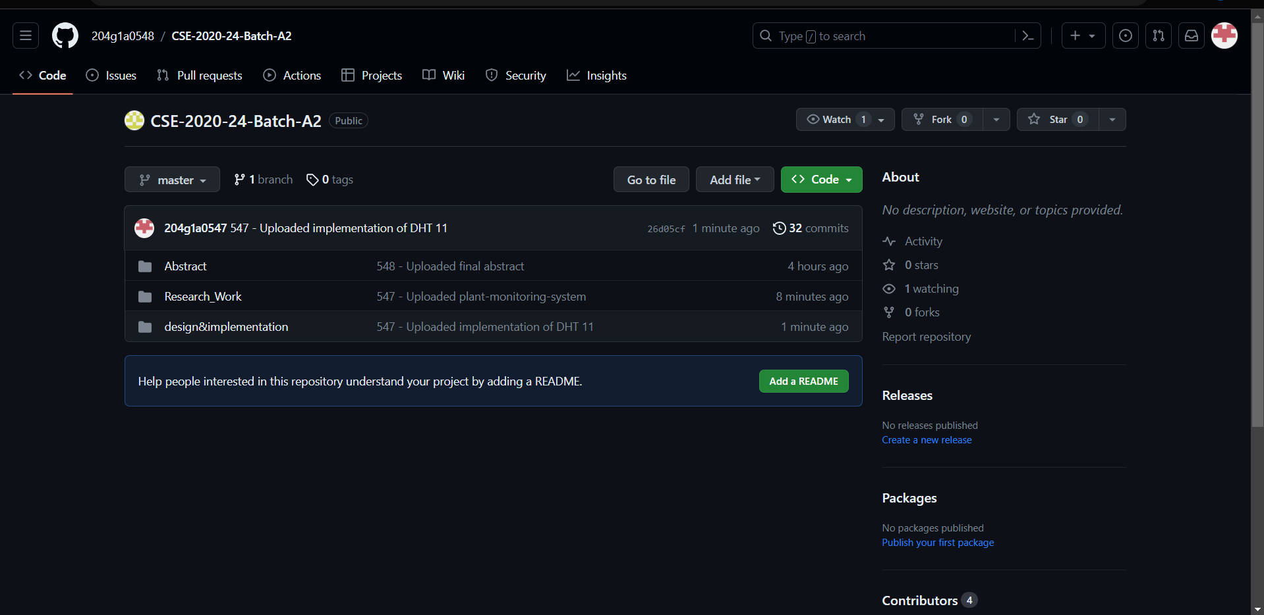
Git Hub Dashboards of each student
Git Hub Link: https://github.com/204g1a0548/CSE-2020-24-Batch-A2.git

Slide 37
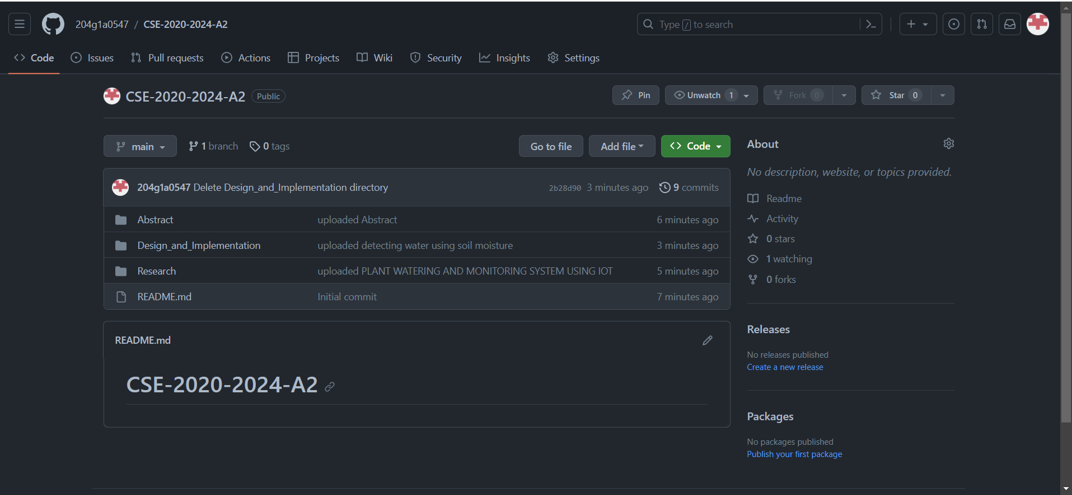
Git Hub Dashboards of each student
Git Hub Link: https://github.com/204g1a0547/CSE-2020-2024-A2.git

Slide 38
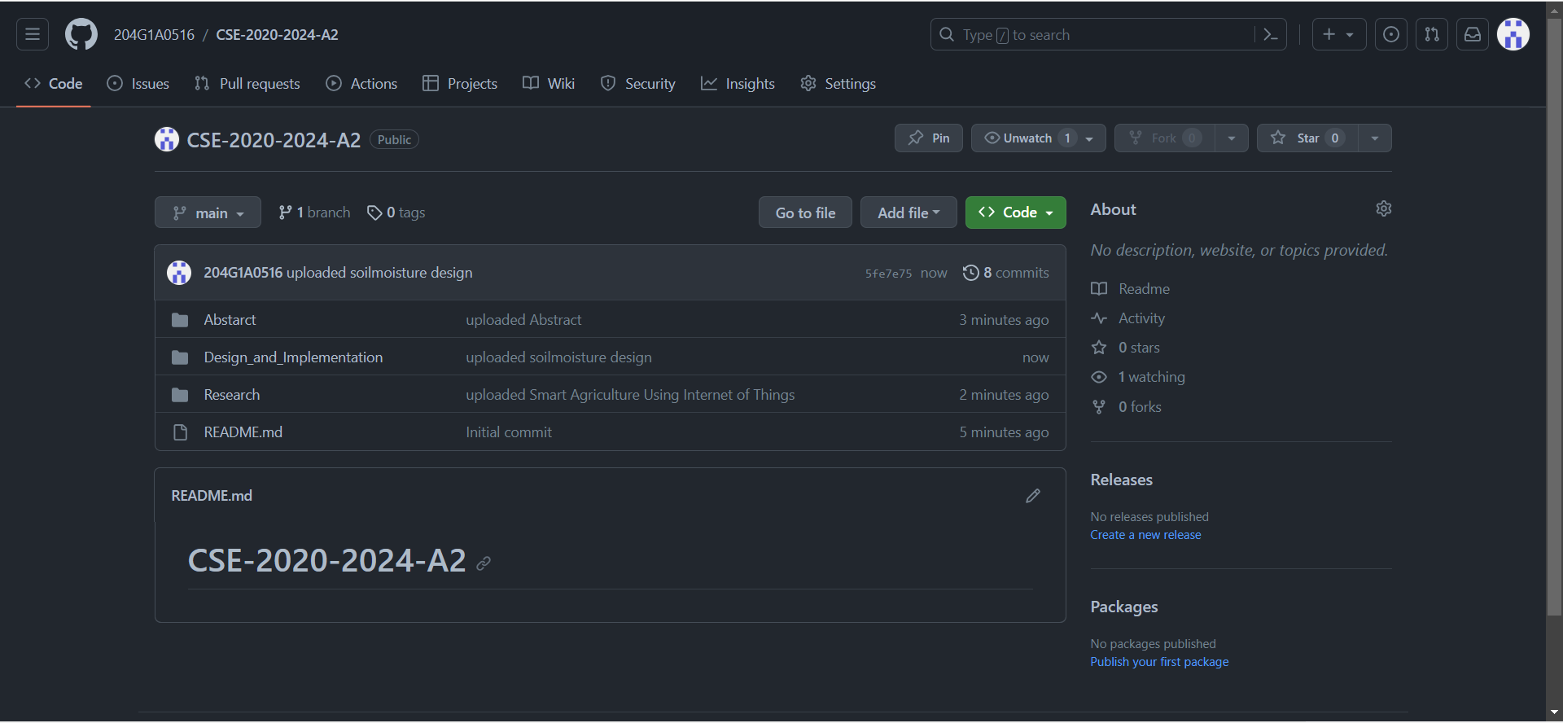
Git Hub Dashboards of each student
Git Hub Link: https://github.com/204G1A0516/CSE-2020-2024-A2.git

Slide 39
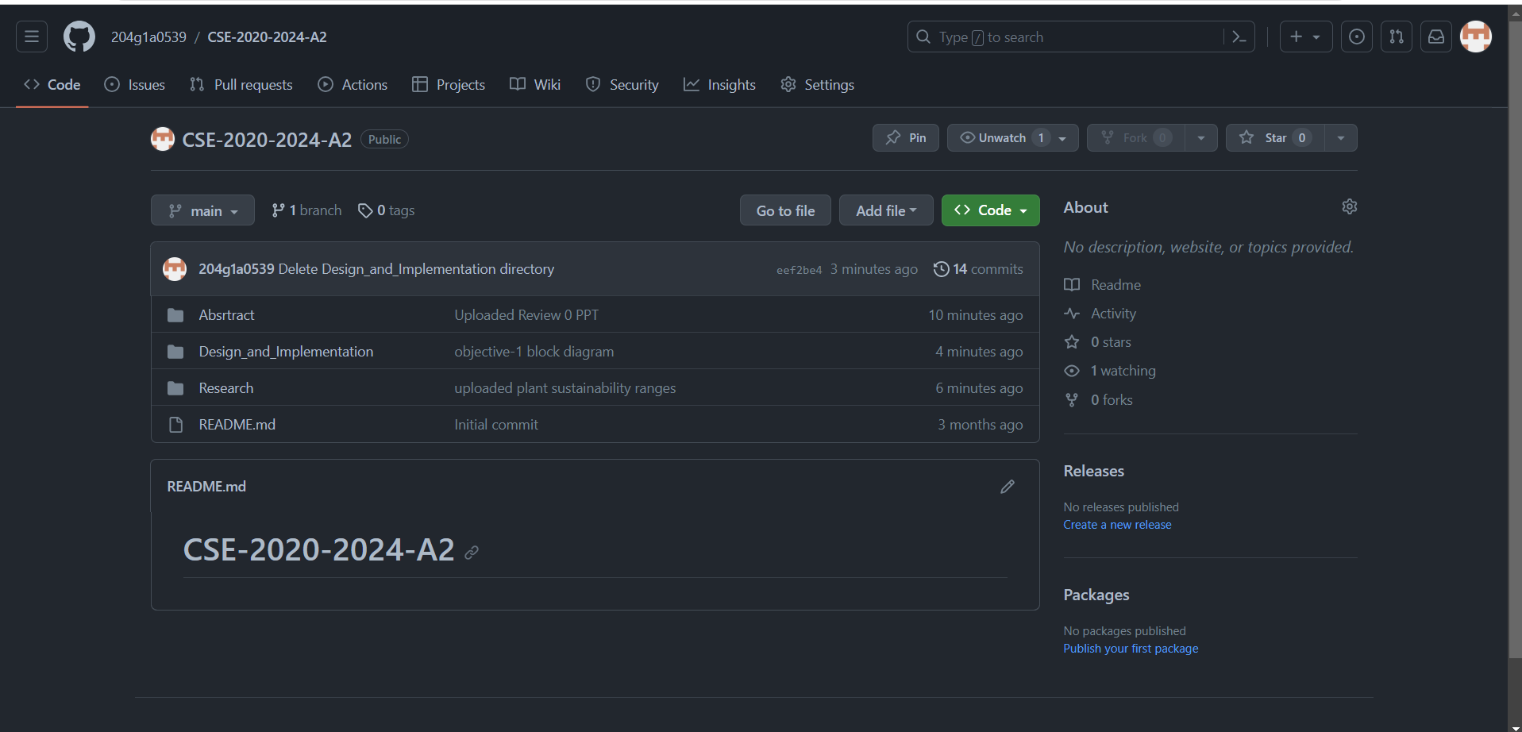
Git Hub Dashboards of each student
Git Hub Link: https://github.com/204g1a0539/CSE-2020-2024-A2.git

Slide 40
Any Queries?

